Slide 2
Essentials of Fire Fighting
6th Edition
Firefighter I
Chapter 13 — Tactical Ventilation

Slide 3
Learning Objective 1
Describe reasons for tactical ventilation.

Slide 4
Tactical ventilation is carefully planned to achieve the best results.
Planned, systematic, coordinated removal
Heated air
Smoke
Performed for
Gases
Other airborne contaminants
Life safety
Incident stabilization
Property conservation
Performed only when fire attack hoselines, teams
In place
Ready to attack

Slide 5
The success of tactical ventilation depends on several factors.
Careful planning
Knowledge of building construction
Systematic application of procedures
Coordination with other activities

Slide 6
Tactical ventilation is performed for several general reasons.
Reduce interior heat levels
Decrease rate of fire spread
Reduce potential of extreme fire behavior
Improve interior visibility
Improve firefighter efficiency
Improve victim survival
Reduce smoke, property damage

Slide 7
Tactical ventilation can be effective when correctly implemented.
Improperly applied – Can impact
Properly implemented
Incident stabilization
Life safety
Property conservation
Firefighters
Occupants
Physical structure

Slide 8
Tactical ventilation can improve life safety, the highest incident priority.
Increasing oxygen concentration
Reducing concentration of toxic products
Reducing temperature
Increasing visibility
Creating smoke-free paths of egress

Slide 9
Incident stabilization can be accomplished through ventilation.
Stages to control, extinguish fire
Locate
Confine
Extinguish

Slide 10
Ventilation can influence property conservation.
Salvage can begin outside of immediate fire area if enough personnel
Ventilation can increase speed of fire extinguishment
Can remove smoke, gases, heat and confine fire to specific area

Slide 11
REVIEW QUESTION
What are the reasons for tactical ventilation?

Slide 12
Learning Objective 2
Identify considerations that affect the decision to ventilate.

Slide 13
Learning Objective 3
Explain the critical fire behavior indicators present during tactical ventilation.

Slide 14
Both occupants and firefighters are at risk during a structural fire.
Occupants – Life hazards
Lower if awake
Several possibilities if asleep
Firefighters – Expected hazards
Visual impairment
Lack of oxygen
Presence of toxic, flammable gases
Rapid fire development possible

Slide 15
Changes in building construction present different risks during fires.
Residential structure and lot size differences
Energy conservation measures
Open plan commercial structures
Layout, construction material changes
Use of plastics, synthetic materials

Slide 16
Knowledge of the building can help make decisions concerning ventilation.

Slide 17
Various building characteristics should be considered when ventilating.
Occupancy classification
Construction type
Floor area, compartmentation
Ceiling height
Number of stories
Number, size of exterior windows, doors, other wall openings
(Cont.)

Slide 18
Various building characteristics should be considered when ventilating.
Number, location of staircases, elevator shafts, dumbwaiters, ducts, roof openings
External exposures
Connection to adjoining structures
Type, design of roof
Type, location of fire protection systems
Contents
HVAC system

Slide 19
Several fire behavior indicators also help with planning for ventilation.
Smoke
Air flow
Courtesy of Bob Espositio
(Cont.)

Slide 20
Several fire behavior indicators also help with planning for ventilation.
Heat
Flame
Courtesy of Mike Wieder

Slide 21
CAUTION
Do not rely solely on the presence or location of flames to assess an incident.

Slide 22
REVIEW QUESTION
How do smoke, air flow, heat, and flame impact fire behavior in a structure?

Slide 23
First arriving units must determine size, location, and extent of the fire.
Uncoordinated ventilation
Can spread fire or cut off escape
Severity, extent of fire depends on several factors
Primary consideration
Phase to which fire has progressed

Slide 24
The type of ventilation used will depend on several factors.
Coordination with other operations
Before orders are given
IC determines if necessary
Conditions upon arrival
Must be appropriate for situation
Must be capable of exhausting volume

Slide 25
The location for ventilation must be selected based on several factors.
Location of occupants
Existing roof openings
Desired air flow path
Building construction
Wind direction
Extent of fire progress
Condition of building, contents
(Cont.)

Slide 26
The location for ventilation must be selected based on several factors.
Potential structural collapse
Effect on fire
Effect on exposures
Readiness of crew
Ability to protect exposures
Protecting means of egress, access

Slide 27
Weather conditions will affect what happens inside a building as well.
Building openings
Other conditions
Wind- most important

Slide 28
CAUTION
A strong wind can overpower the natural convective effect of a fire and drive the smoke and hot gases back into the building.

Slide 29
Exposures should be taken into account when planning ventilation.
Internal
Affected by routing of smoke
External
Affected by radiation, direct flame contact
Ventilation can create danger

Slide 30
Staffing and resources are both requirements for ventilation.
Resources needed
Forcible entry tools
Power saws
Fans or blowers
Smoke ejectors
Flexible ducts
Stacking and hanging devices
Other support systems
Electrical power cords
Generators

Slide 31
REVIEW QUESTION
What considerations will affect the decision to ventilate?

Slide 32
Learning Objective 4
Define horizontal and vertical ventilation.

Slide 33
Learning Objective 5
Explain the means for achieving horizontal and vertical ventilation.

Slide 34
There are two main types of tactical ventilation that can be performed.
Horizontal Ventilation
Heat, smoke, other parts of combustion channeled out through existing or created horizontal openings
(Cont.)

Slide 35
There are two main types of tactical ventilation that can be performed.
Vertical Ventilation
Ventilating at point above the fire; channeling contaminated atmosphere out the top

Slide 36
There are three means to accomplish ventilation used in the fire service.
Natural
Mechanical
Hydraulic

Slide 37
There are several indicators of the need for mechanical or hydraulic ventilation.
Location, size determined
Layout not conducive to natural
Natural slows, needs support
Fire below ground
Involved area too large for natural
Building or fire dictates other method

Slide 38
REVIEW QUESTION
What are the basic means used to accomplish ventilation?

Slide 39
Learning Objective 6
Describe the types of horizontal ventilation.

Slide 40
Horizontal ventilation can be applied to several types of structures.
Building where fire has not involved attic, cockloft
Multistory building with fire below top floor, or top floor if attic uninvolved
Building so weakened unsafe for vertical ventilation
Building with daylight basement
Building where vertical ventilation ineffective

Slide 41
Natural horizontal ventilation works with existing conditions to take advantage of natural air flow.

Slide 42
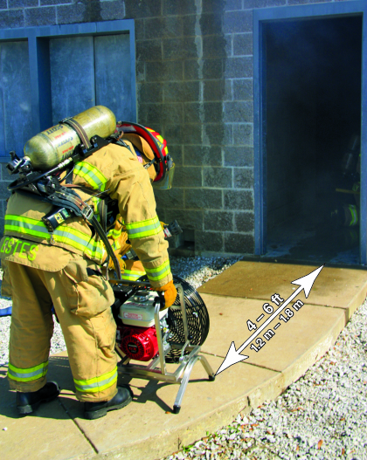
There are two types of mechanical horizontal ventilation.
Negative-pressure ventilation (NPV)
Positive-pressure ventilation (PPV)

Slide 43
NPV uses smoke ejectors to expel and pull smoke from a structure.
Know placement process
Understand selection and use
In windows openings
On leeward side
Properly seal
Flow of smoke, gases
Remove obstacles
Do not allow ejector to be obstructed
Use intrinsically safe if needed
Turn off when carrying
Cautions before starting
Avoid air discharge from an
Avoid opening windows, doors near ejector

Slide 44
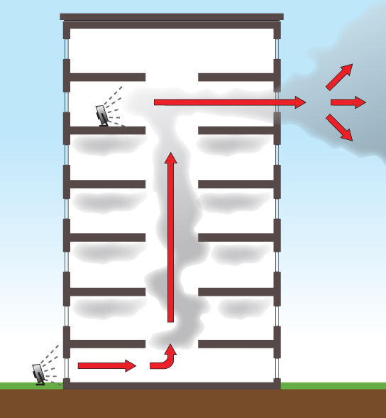
PPV uses a fan to create slightly higher pressure inside a structure than is outside.

Slide 45
WARNING!
Improperly applied, PPV can change the interior conditions and injure personnel working inside the structure.

Slide 46
PPV has both advantages and disadvantages.
Advantages
Disadvantages
Effectiveness
Set up
Efficiency
Limits currents
Operate efficiently
Cleaning, maintenance less
Effective in all structure types
Able to direct
Can be pressurized
Structure must be intact
May increase interior carbon monoxide levels if fan exhaust enters
May accelerate, spread hidden fires

Slide 47
Hydraulic ventilation is used when other types of forced ventilation are unavailable.

Slide 48
REVIEW QUESTION
What are the main types of horizontal ventilation?

Slide 49
You should know the precautions against upsetting horizontal ventilation.
May pressurize building, intensify fire, cause fire spread
May reduce or eliminate positive effects of air currents

Slide 50
Mechanical ventilation has both advantages and disadvantages.
Advantages
Disadvantages
Enhances natural ventilation
Ensures more air flow control
Speeds removal of contaminants
Reduces smoke damage
Promotes good public relations
Benefits spaces with low oxygen levels
Can cause fire to intensify, spread
Depends on power source
Requires special equipment, additional resources and personnel

Slide 51
REVIEW QUESTION
How do the advantages and disadvantages of natural, mechanical, and hydraulic ventilation compare to one another?

