Slide 2
Learning Objective 7
Describe the types of vertical ventilation.

Slide 3
Vertical ventilation occurs after the Incident Commander considers several factors.
Need for ventilation
Age, type of structure involved
Location, duration, extent of fire
Safety precautions
Escape routes
If it can be done safely, effectively
Location for ventilation
Personnel, tools moved

Slide 4
Vertical ventilation presents several risks the IC must assess.
Risks
Personnel working above ground level on peaked, flat surfaces
Working above fire, on weakened roofs
Determine if offensive or defensive
Offensive – Aids in reaching, extinguishing fire
Defensive – Stop spread of fire, contains in one area

Slide 5
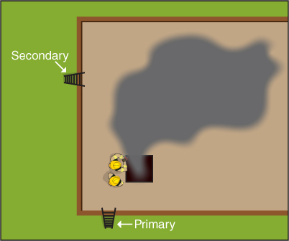
Safety precautions should be used during vertical ventilation.
Provide secondary means of escape
Note obstructions, excessive weight
Check wind direction, velocity
(Cont.)

Slide 6
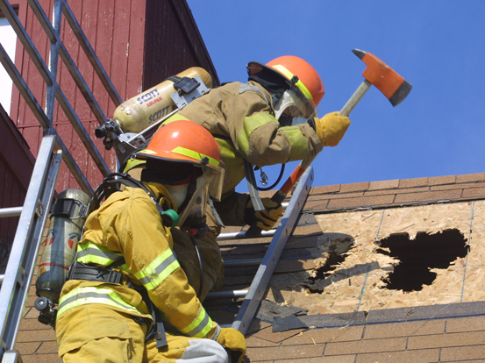
Safety precautions should be used during vertical ventilation.
Prevent personnel from sliding, falling off roof
Secure ladder firmly
Evacuate promptly
Ensure main structural supports not cut
Guard opening
(Cont.)

Slide 7
CAUTION
Roof ladders are only meant to prevent slipping and are not intended to be used on fire-weakened roofs.

Slide 8
Safety precautions should be used during vertical ventilation.
Caution when around electric wires, solar panels, guy wires
Wear full PPE
Keep out of range of swinging axes, power saws
Remain aware of overhead obstructions
Power tool cautions
Extend ground ladders above edge of roof or top of wall
(Cont.)

Slide 9
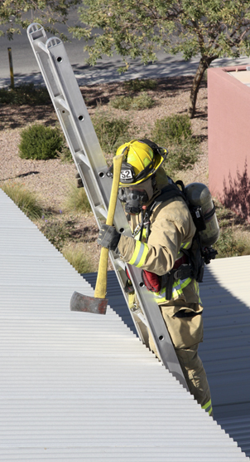
Safety precautions should be used during vertical ventilation.
Ensure aerial platform even or slightly above roof
Walk on load-bearing walls, strongest parts
Penetrate ceiling to enhance ventilation
Check roof structural integrity

Slide 10
WARNING!
Never direct a fire stream into a vertical exhaust opening when interior attack crews are inside the structure because it will force smoke, heat, and steam down on them.

Slide 11
Knowing what to expect when sounding a roof is important.

Slide 12
CAUTION
Work in groups of at least two, but with no more personnel than absolutely necessary to perform the assigned task.

Slide 13
Roof-cutting operations require specific resources and skills.
Courtesy of Matt Daly

Slide 14
Roof ventilation leaders have specific responsibilities to perform.
Ensure
Coordinate with firefighters inside
Ensure
Roof safe
Only require openings made
Minimize secondary damage
Two means of egress
Safety of personnel
Adequate exhaust opening size
Team leaves when assignment completed

Slide 15
Various types of inspection holes can be used during ventilation.
Kerf cut
Triangle cut

Slide 16
Offensive ventilation methods depend on the opening and roof type.
Critical points when cutting
Square or rectangular
Easier to repair after fire
One opening better than several small ones

Slide 17
A square or rectangle is the most common opening made in a flat roof.

Slide 18
Different types of roofs require different ventilation tactics.
Pitched roof, shingle-covered
Pitched roof, slate or tile-covered
Arched roofs
Metal roofs

Slide 19
The trench cut is strictly a defensive ventilation method.

Slide 20
The process for making a trench cut follows specific procedures.
Opening created ahead of fire
Only after vertical ventilation opening made
Created by
Two parallel cuts
Remove roof material
Push ceiling material down
Improper cut
Places firefighters in dangerous position
May cause fire spread more rapidly

Slide 21
REVIEW QUESTION
What are the types of vertical ventilation?

Slide 22
All ventilation team members should follow safety practices.
Establish and maintain communication
Be aware
Have clear understanding of objectives
Have charged hoseline present
Wear full PPE and SCBA
Have two means of escape
Assign roof safety officer
Cut small inspection holes on both fire, safe working side
Plan ahead

Slide 23
You should know the precautions against upsetting vertical ventilation.
Factors that can reduce effectiveness
Not a solution to all ventilation problems

Slide 24
WARNING!
Do not direct a fire stream into a ventilation opening during offensive interior operations.

Slide 25
REVIEW QUESTION
What differences are there between horizontal and vertical ventilation?

Slide 26
Learning Objective 8
Recognize other types of ventilation situations.

Slide 27
Other types of ventilation situations, such as basement fires, may arise.
Basement fire
Heat, smoke spread upward
Access can be difficult without ventilation
Several ventilation methods

Slide 28
Other types of ventilation situations exist, such as windowless buildings.
Windowless buildings
Complicate operations
Problems vary
Usually requires mechanical for smoke removal
Can cause delays
Allow systems to work if designed to contain combustion products

Slide 29
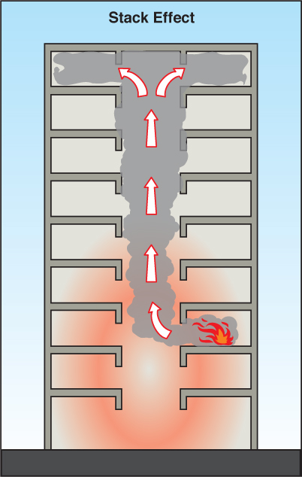
High-rise fires are also another type of ventilation situation that may arise.
High-rise fires
Higher life safety considerations present
More personnel required
Consider smoke spread, hot gas layer development

Slide 30
Tactical ventilation must be considered during preincident planning.
Usually accomplished horizontally
Only one stairwell may penetrate roof
Control doors on uninvolved floors
Ventilating draws smoke up into stairwell between fire floor and roof
PPV fans should be located at bottom floor
Ventilation fans may be built into top of stairwell

Slide 31
WARNING!
Do not use stairwells or elevator shafts simultaneously for both evacuation and ventilation.

Slide 32
REVIEW QUESTION
What other types of ventilation situations might firefighters encounter?

Slide 33
Learning Objective 9
Explain the effects of building systems on tactical ventilation.

Slide 34
Ventilation will have several effects on building systems.
Modern HVAC may contribute to fire spread
Systems usually controlled from panel in basement, ground level
Restoring system responsibility of building staff
Ductwork may create additional fire damage

Slide 35
Built-in smoke control systems are designed to confine fire.

Slide 36
WARNING!
Do not attempt to operate building systems that assist in ventilation.

Slide 37
REVIEW QUESTION
How can a built-in heating ventilation and air conditioning (HVAC) system affect tactical ventilation?

Slide 38
Summary
Tactical ventilation of a burning building allows heat, smoke, and fire gases to escape to the atmosphere and also draws fresh air into the building.
Properly applied tactical ventilation allows firefighters to see better, locate victims more easily, and find the seat of the fire sooner.
(Cont.)

Slide 39
Summary
Tactical ventilation limits fire spread and channels heat and smoke away from trapped victims; but must be correctly coordinated.
(Cont.)

Slide 40
Summary
Firefighters must understand fire behavior, know various ventilation methods and have knowledge of roof construction and know how to create exhaust openings in all types of roofs that have a variety of openings in order to perform ventilation correctly.

