Slide 1
IFSTA Chapter 16 Fire Streams
Part 2

Slide 2
Learning Objective 5
Describe the three types of fire stream nozzles.

Slide 3
Fire stream nozzles fall into different categories but have the same functions.
NFPA® 1963
Straight tip (Smooth bore)
Not in standard
Broken-stream devices
Functions of both
Control water flow
Create reach
Shape fire stream
Spray (Fog)

Slide 4
DISCUSSION QUESTION
What terms have you heard that refer to various types of nozzles?

Slide 5
The design of smooth bore nozzles reduce the shape of water in the nozzle.
Courtesy Elkhart Brass Manufacturing Company, Inc.
Courtesy of Task Force Tips
Courtesy of Akron Brass Company

Slide 6
Smooth bore nozzles have several characteristics you should know.
Operate at low nozzle pressures
Less prone to clogging with debris
Used to apply compressed-air foam
May allow hoselines to kink
Do not allow for selection of different stream patterns

Slide 7
The flow rate of smooth bore nozzles depends on two concepts.
Velocity of stream
Size of nozzle
Result of nozzle pressure
Tips may be equipped for flow rate

Slide 8
Fog nozzle operation can create several patterns using specific pressure.
Patterns
Narrow-angle fog
Wide-angle fog
Straight stream
Should be operated at designed pressures

Slide 9
The characteristics of fog nozzles fall into several categories.
Discharge pattern can be adjusted
Can provide protection to firefighters
Offer variety of nozzle choices
Can be used to apply certain types of foam
Can be used for variety of applications

Slide 10
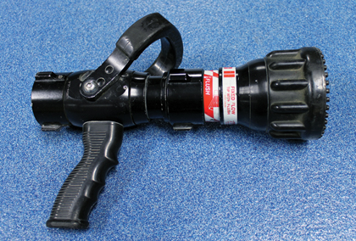
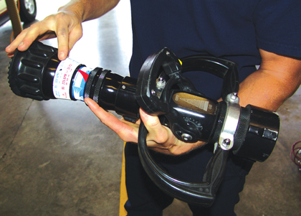
There are several types of fog nozzles to use on the fireground.
Courtesy of Shad Cooper, Wyoming State Fire Marshal’s Office
Basic
Constant pressure (automatic)
Constant/ select gallonage
Constant gallonage

Slide 11
Manually adjustable fog nozzles can allow rate of discharge changes.
Located behind nozzle tip
Flow constant as long as pressure present
Operator can make choice
May have flush setting
Make adjustments in small increments
Before opening
While flowing
Rates depend on nozzle size

Slide 12
CAUTION
Abrupt changes in the reaction force of the hoseline may throw firefighters off balance.

Slide 13
Constant-pressure fog nozzles automatically vary flow rate to maintain constant pressure.
Minimum nozzle pressure needed
Operator can
Automatic nozzles for
Change flow with shutoff valve
Vary flow while maintaining constant pressure
Master stream nozzles – Designed for range
Handlines – Designed for low, mid-range, high flow

Slide 14
Fog nozzles are designed to operate at a variety of nozzle pressures.
Most – 100 psi (700 kPa)
75, 50, 45 psi (525, 350, 315 kPa) also available

Slide 15
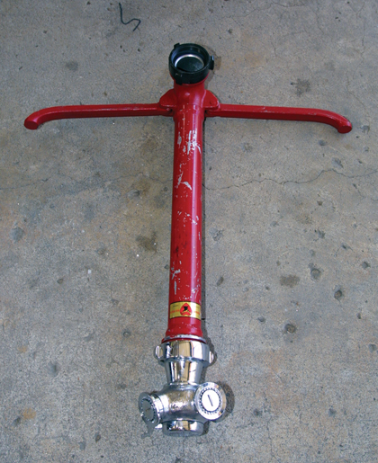
Broken stream delivery devices can be used for concealed space fires.
Piercing nozzles
Bresnan distributors
Rockwood cellar pipe
Courtesy of Shad Cooper, Wyoming State Fire Marshal’s Office

Slide 16
REVIEW QUESTION
What are the benefits of each of the types of fire stream nozzles?

Slide 17
Learning Objective 6
Compare the different types of nozzle control valves.

Slide 18
Nozzle control valves allow the operator to accomplish several tasks.
Influence flow of water
Start, stop
Open nozzle slowly
Increase, decrease
Control nozzle reaction increases
Close slowly
Prevent water hammer

Slide 19
The ball valve is the most common type of nozzle control valve.

Slide 20
The slide valve uses a moveable cylinder to turn off water flow.

Slide 21
The rotary control valve is only found on rotary control fog nozzles.

Slide 22
REVIEW QUESTION
How do the different types of nozzle control valves compare with one another?

Slide 23
Learning Objective 7
Describe the factors in operating and maintaining handline nozzles.

Slide 24
Operating smooth bore nozzles requires understanding the force they create.
Water flow creates force in direction of stream
Equal force in opposite direction
Pushes back on operator
Caused by
Makes nozzle difficult to handle

Slide 25
Smooth bore nozzles are controlled by using specific steps.
Cradle hoseline in one arm and hold nozzle, pistol grip in one hand
Pull slowly back on bale with other hand, open nozzle
As action increases -
Interior operation – Operate in similar fashion, kneeling on one knee
Lean forward with both legs apart, one foot forward, weight distributed evenly on both feet
Personnel required
One person – 1½ inch (38 mm) or smaller
Additional – 1¾ inch (44 mm)

Slide 26
Fog nozzle operation will vary depending on the setting used.
Pattern
Wider pattern – Reaction decreases
Handle same as smooth bore
Straight-stream, narrow-stream similar to smooth bore

Slide 27
Nozzle inspection is performed after every use or at least annually.
Maintenance, care, cleaning
Technical maintenance

Slide 28
Nozzle inspection actions can be the same no matter what type of nozzle.
Inspect swivel gasket
Look for external damage
Ensure pistol grip secured to nozzle
Check for ease of operation
Ensure all parts in place, good condition
Look for internal damage, debris

Slide 29
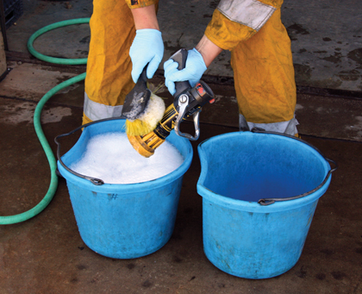
There are several steps to follow for general nozzle care.
Thoroughly clean after each use
Follow manufacturer’s recommendations to clean, lubricate moving parts
Never drop or drag nozzle
Use flush setting on fog nozzle, remove internal debris
Store with valve control bale in closed position

Slide 30
REVIEW QUESTION
What are the main factors to consider when operating and maintaining a handline nozzle?

Slide 31
Summary
Firefighters must know the extinguishing properties of water, and the properties of the nozzles available in their departments.
They must understand the factors affecting fire streams.
They must know how to select, operate, and maintain the nozzles available in their department.

