Slide 1
Fire Loss Control
Part 2

Slide 2
Salvage operation assignments vary depending on the department.
Ladder or specially designated companies
All firefighters are trained
Engine companies carry equipment

Slide 3
There are various types and sizes of salvage covers.
Canvas
Vinyl
Disposable heavy-duty plastic

Slide 4
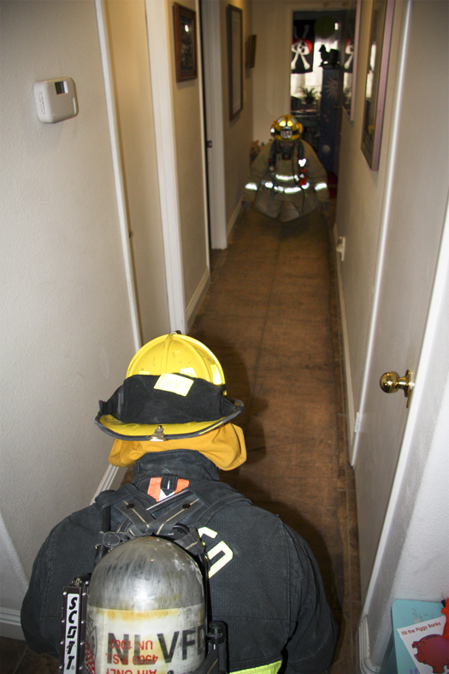
Salvage requires a specific collection of tools and equipment stored in a designated toolbox or container.
(Cont.)
Carryall
Floor runners

Slide 5
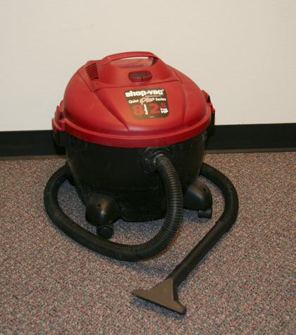
Salvage requires a specific collection of tools and equipment stored in a designated toolbox or container.
Water vacuum
(Cont.)
Dewatering device

Slide 6
Salvage requires a specific collection of tools and equipment stored in a designated toolbox or container.
J-hooks
S-hooks

Slide 7
REVIEW QUESTION
What are the different types of salvage covers commonly used in the fire service?

Slide 8
Learning Objective 5
Explain ways to fold, roll, spread, and improvise with salvage covers.

Slide 9
Learning Objective 6
Describe ways to cover openings during salvage operations.

Slide 10
There are several different methods for folding/rolling and spreading covers.
One- firefighter, rolled cover
One-firefighter, folded cover
Two- firefighter, folded cover

Slide 11
REVIEW QUESTION
Why is it necessary to know several ways to fold, roll, spread, and improvise with salvage covers?

Slide 12
Covering openings is critical to prevent further damage to the property.
Doors or windows
Openings in roofs
Openings in upper story floors, basements, crawl spaces

Slide 13
REVIEW QUESTION
What ways can firefighters cover openings during salvage operations?

Slide 14
Overhaul consists of activities conducted once the main body of a fire is extinguished.
Searching for, extinguishing hidden fire
Placing building, contents in safe condition
Determining cause of fire
Recognizing, preserving evidence of arson

Slide 15
Overhaul begins once authorization is given by two personnel.
Incident Commander
Individual responsible for fire investigation

Slide 16
A variety of tools and equipment are used during overhaul.
Pike poles, hooks
Axes
Prying tools
Power saws, drills, screwdrivers
Carryalls, buckets, tubs
Shovels, bale hooks, pitchforks
Thermal imager

Slide 17
Specific personnel perform different duties during overhaul.
Supervisor, officer
If not involved directly in overhaul – Visually direct overhaul operations
Fire investigator
If on scene – Be involved in planning, supervising overhaul

Slide 18
Safety is the first consideration that must be addressed before overhaul.
Inspect premises
Develop operational plan
Provide needed tools
Eliminate, mitigate hazards
Monitor atmosphere before removing SCBA

Slide 19
Toxic gases produced from smoldering fire are a significant threat.

Slide 20
CAUTION
Wear proper protective clothing including self-contained breathing apparatus (SCBA) until the atmosphere has been proven safe.

Slide 21
Many other hazards are present during overhaul that you should be aware of.
Fire-weakened floors
Mark or barricade hazardous areas
Broken glass, nails, sharp objects
Cuts, punctures, thermal burns if not wearing gloves
Eye injuries
Prevent strains, sprains through conditioning, practice
Fatigue – More susceptible to injury

Slide 22
Charged hoselines are required during overhaul due to threat of reignition.

Slide 23
Situational awareness and a focus on safety are critical during overhaul.
Work in teams of 2 or more
Maintain awareness of exit routes
Maintain RIC/RIT
Monitor personnel for rehab needs
Beware of hidden gas or electrical utilities
Continue using accountability system until incident terminated

Slide 24
REVIEW QUESTION
What methods can be used to maintain fire safety during overhaul operations?

Slide 25
The structural condition of an area must be evaluated before searching for hidden fires.
Intensity of fire
Extent of structural member weakness
Amount of water used
Additional weight placed on floors, walls

Slide 26
There are several indicators of possible loss of structural integrity.
Weakened floors
Walls offset
Concrete that has spalled
Weakened steel roof members
Weakened roof trusses
(Cont.)

Slide 27
There are several indicators of possible loss of structural integrity.
Mortar in wall joints opened
Water pooled on upper floors
Large quantities of wet insulation
Wall ties holding veneer/curtain walls melted
Heavy storage on mezzanines or upper floors

Slide 28
There are four methods to use when locating hidden fires.
Sight
Touch
Sound
Electronic Sensors

Slide 29
REVIEW QUESTION
How can a firefighter describe the factors that influence locating hidden fires?

Slide 30
Overhaul procedures should begin as soon as possible after the order is given.
If extended to other areas, determine path
If floor beams burned at party wall ends, flush voids
Thoroughly check insulation materials
(Cont.)

Slide 31
Overhaul procedures should begin as soon as possible after the order is given.
Understanding basic building construction can help
Search in concealed spaces
Consider if concealed space indicates utilities
Do not make random openings
(Cont.)

Slide 32
Overhaul procedures should begin as soon as possible after the order is given.
Open ceilings from below
Do not stand directly under when pulling ceiling
Make openings in neat, planned manner
(Cont.)

Slide 33
Overhaul procedures should begin as soon as possible after the order is given.
Small burning objects frequently uncovered
Large smoldering items taken outside
Do not disturb evidence
Use of wetting agents valuable

Slide 34
REVIEW QUESTION
What are some of the overhaul procedures used in the fire service?

Slide 35
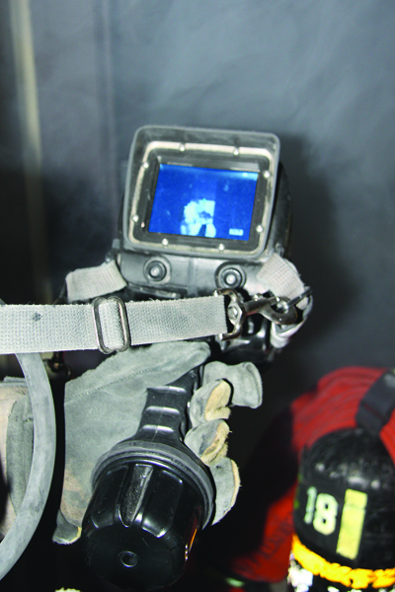
Using thermal imagers during overhaul has benefits and disadvantages.

Slide 36
Summary
Loss control is an important component of fire department service delivery with the philosophy of minimizing secondary damage to structures and their contents during and after fire control operations.
Salvage and overhaul operations are two of the most effective means of loss control.
(Cont.)

Slide 37
Summary
It is very important for fire personnel to identify and protect valuable contents in structures affected by fire as well as searching for hidden fires so rekindling does not occur.
(Cont.)

Slide 38
Summary
Taking a customer-service oriented approach to loss control ensures that citizens’ property is adequately protected and that the reputation of the fire service is held in the highest regard.

