Slide 2
Learning Objective 2
Describe the relationship between fire cause classifications and cause determination.

Slide 3
Fire cause determination is a critical step in the investigation process.
Look for
Competent ignition source
Ignition sequence
Determination can
Document causes of fire
Indicate trends in unsafe behavior
Indicate defective equipment, design flaws
Indicate malicious, illegal behavior

Slide 4
The National Fire Incident Reporting System (NFIRS) reports several causes of fires in structures.
Incendiary
Other heat, flame, or spark
Smoking materials
Open flame, ember, or torch
(Cont.)

Slide 5
The National Fire Incident Reporting System (NFIRS) reports several causes of fires in structures.
Lightning, natural
Heating equipment
Cooking equipment
Electrical or lighting equipment
(Cont.)

Slide 6
The National Fire Incident Reporting System (NFIRS) reports several causes of fires in structures.
Heating, ventilating, and air-conditioning (HVAC) appliances
Other equipment
Exposure
Children playing with matches, lighters, or other ignition sources

Slide 7
There are four types of fire cause classifications.
Accidental
Natural
Incendiary
Undetermined
Courtesy of Donny Howard
Courtesy of Iowa Fire Service Training Bureau.

Slide 8
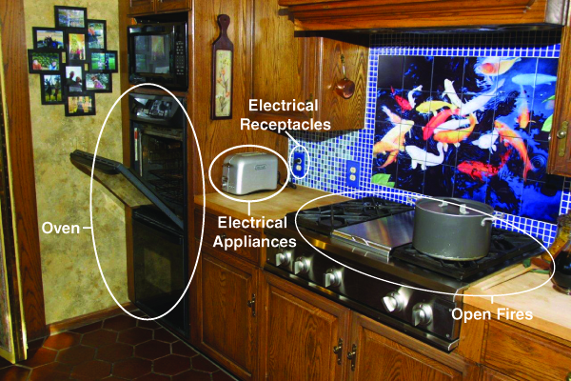
There are several obvious signs of cause you should look for.
Courtesy of Bob Espositio

Slide 9
DISCUSSION QUESTION
What are some visual signs that may determine the area of origin for ground cover fire?

Slide 10
Absence of an obvious ignition source can help investigations.
Eliminate some causes
Focus on other causes

Slide 11
REVIEW QUESTION
What is the relationship between fire cause classifications and cause determination?

Slide 12
Learning Objective 3
Recognize signs of arson.

Slide 13
You will need to provide information if an incendiary or undetermined initial cause is indicated.
Gather based on
Different personnel may perform formal investigation
Observations
Local or state fire investigators
Law enforcement officials
(Cont.)

Slide 14
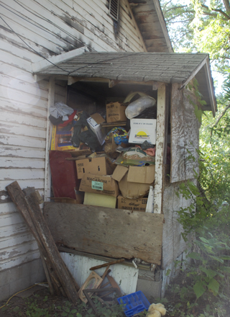
You will need to provide information if an incendiary or undetermined initial cause is indicated.
Time of day
Weather, natural hazards
Manmade barriers
People leaving the scene
Courtesy of Donny Howard

Slide 15
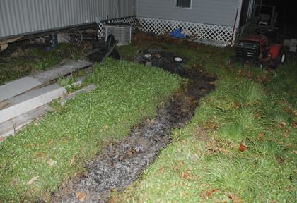
Additional information should also be gathered to assist investigators.
Time of arrival and extent of fire
Wind direction and velocity
Doors or windows locked or unlocked
Location of fire
(Cont.)
Courtesy of Donny Howard

Slide 16
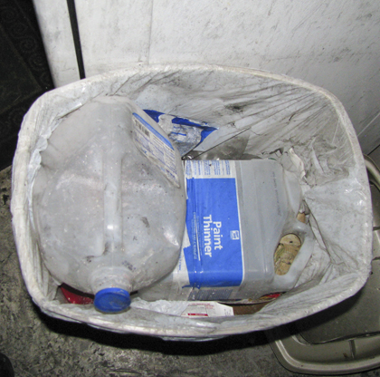
Additional information should also be gathered to assist investigators.
Containers or cans
Burglary tools
Familiar faces
Courtesy of Donny Howard

Slide 17
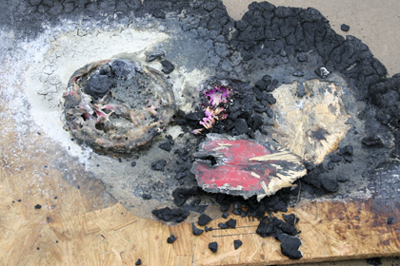
Conditions should also be observed to provide information for investigators.
Unusual odors
Abnormal behavior of fire when water applied
Obstacles hindering fire fighting
Incendiary devices
(Cont.)

Slide 18
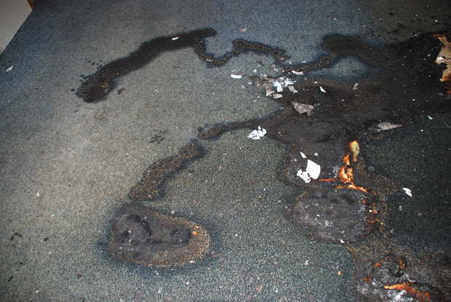
Conditions should also be observed to provide information for investigators.
Trailers
Structural alterations
Fire patterns
Heat intensity
Courtesy of Donny Howard
(Cont.)

Slide 19
Conditions should also be observed to provide information for investigators.
Availability of documents
Fire detection and protection systems
Intrusion alarms
Location of fire
(Cont.)

Slide 20
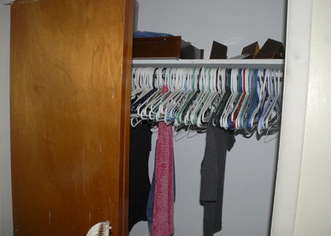
Conditions should also be observed to provide information for investigators.
Personal possessions
Household items
Equipment or inventory
Business records
Courtesy of Donny Howard

Slide 21
REVIEW QUESTION
How can a Firefighter I recognize signs of arson?

Slide 22
Learning Objective 4
Describe the importance of
preserving evidence.

Slide 23
Learning Objective 5
Explain techniques for
preserving evidence.

Slide 24
Preserving evidence requires understanding certain principles.
Responsibility of all at scene
Do not determine what is/is not unless qualified
Protect everything that looks odd, suspicious

Slide 25
There are several important aspects of protecting the fire scene.
Scene security - First
Early security measures
Restrict scene access
Protect potential evidence
Minimize suppression, overhaul activities that could destroy information
First-arriving investigator
May adjust or implement new measures
Decision factors
May request monitoring of each entrance, exit to document individuals on scene

Slide 26
Establishing a scene perimeter requires specific knowledge.
Explosions
Structure
Courtesy of Ron Moore, McKinney (TX) Fire Department

Slide 27
There are several ways to establish perimeters that are both recognizable and enforceable.
Ensure initial larger than needed
Ensure visible, recognizable
Use law enforcement or firefighters to control

Slide 28
Procedures for criminal investigations also impact scene security practices.
Keep entry log
Permit access to only those authorized
Move personnel to staging area when tasks complete
Ensure others always escorted
Mark potential evidence to prevent disturbing

Slide 29
There are several techniques used to preserve evidence.
Keep evidence untouched, undisturbed
Do not gather or handle unless necessary to preserve
Document all actions
Follow department SOPs
(Cont.)

Slide 30
There are several techniques used to preserve evidence.
Avoid walking on, cross-contaminating, or destroying
Close dampers and other openings
Avoid excessive water use
Protect footprints, tire marks
Leave charred documents
Protect documents from air flow

Slide 31
Overhaul operations can be detrimental to an investigation.
May destroy potential evidence
Delay until origin and cause determined
Begin once critical evidence protected

Slide 32
Even when a scene is secure, contamination or spoliation can occur.
Contamination
Spoliation
Courtesy of Donny Howard

Slide 33
Follow local procedures when finalizing operations and investigations.
After investigation complete
Debris removal
Secure structure, turn over to occupant
Perform according to local SOPs
Follow local protocol
May be last activity
Prevent rekindle
Separate unburned
Dump debris where not visible if possible

Slide 34
REVIEW QUESTION
What are some techniques firefighters can use to preserve evidence?

Slide 35
Summary
One of the most important responsibilities is protecting evidence.
Use appropriate caution in the area of origin.
A thorough investigation can be conducted to determine the exact cause of the fire.

