Slide 1
United States Forest Service Fire & Aviation Management
Safety First as a Core Value

Slide 2
Firefighter Training, S-130
Introduction to Fire fighting

Slide 3
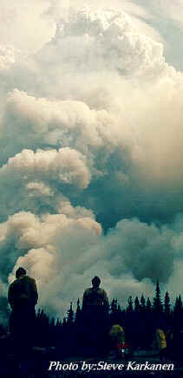

Slide 4
Course Objectives
Construct fire line to required standards, using various methods for construction.
Strengthen, reinforce and use holding actions on the fire line.
Extinguish the fire with or without the use of water.
Locate yourself and the fire on a map

Slide 5
Objectives (continued)
Assess and report fire situation data (written or oral) by radio and/or messenger.
Complete assigned tasks in a safe and efficient manner.
Given and assignment in a wildfire environment, describe factors in that environment which could impact safety.

Slide 6
Safety
Safety is defined as freedom from exposure to danger.

Slide 7
Fire fighters’ Requirements
Knowledge and skill in methods of avoiding accidents, injury and exposure to danger.
An ability and attitude that grows with experience and training.
Fire fighting personnel must use the knowledge and skills gained through training and experience in all situations.

Slide 8
Safety Rules
LCES - Lookouts, Communications, Escape Routes and Safety Zones
The 18 Situations that Shout Watch Out
The Ten Standard Fire Orders

Slide 9
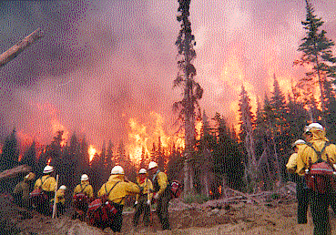

Slide 10
Fire Orders
Fight fire aggressively but provide for safety first
Initiate all actions based on current and expected fire behavior
Recognize current weather conditions and obtain weather forecasts
Ensure instructions are given and understood
Obtain current information on fire status
Remain in communication with crew members, your supervisor and adjoining forces
Determine safety zones and escape routes
Establish lookouts in potentially hazardous situations
Retain control at all times
Stay alert, keep calm, think clearly and act decisively

Slide 12
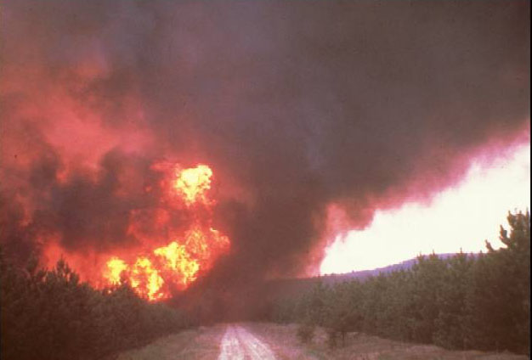

Slide 13
Types of Hazards
Subjective Hazards: are hazards that we have direct control over.
Example: condition of equipment, the decision to turn your back.
Objective Hazards: are hazards that we have no control over.
Lightning
Fire weakened timber
Rolling rocks, logs
Entrapment by fire

Slide 14
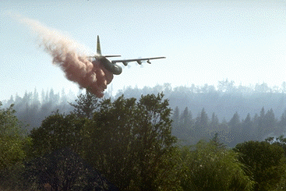

Slide 15
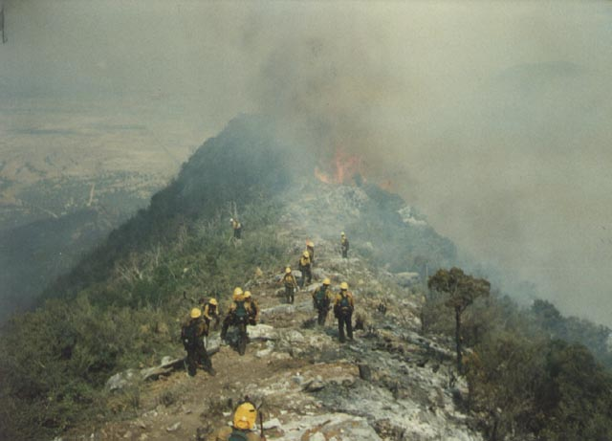

Slide 16
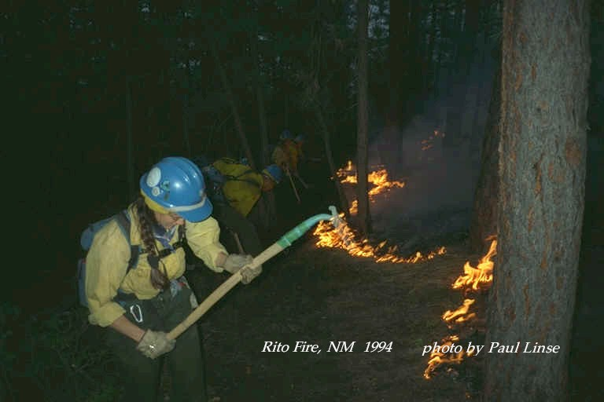

Slide 17
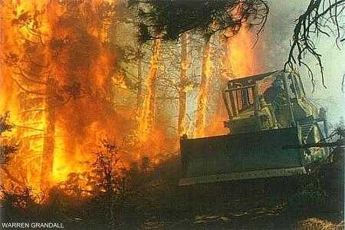

Slide 18
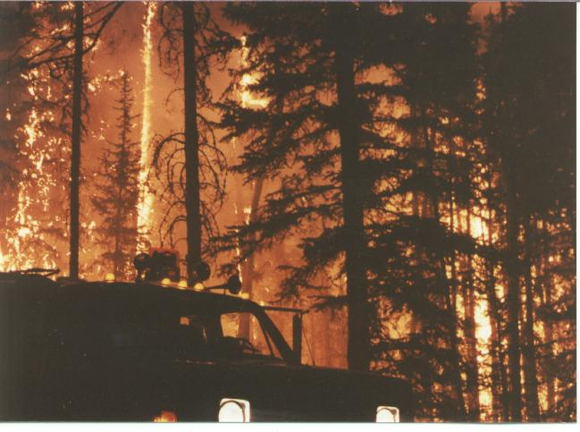

Slide 19
Environmental Hazards
Heat stress
Hypothermia
Darkness
Carbon monoxide
Dust

Slide 20
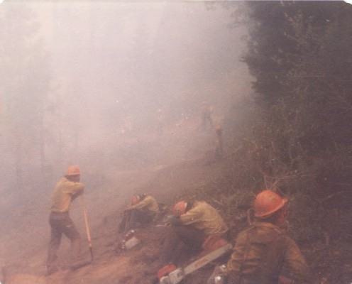

Slide 21
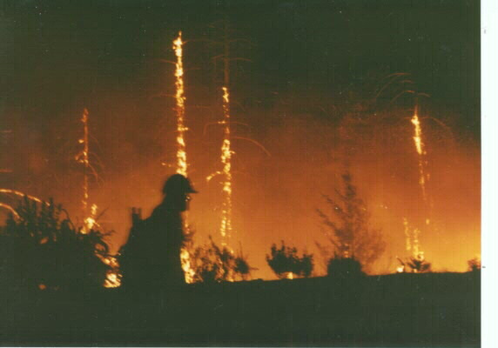

Slide 22
Biological Hazards
Snakes
Insects (bees, ticks, etc.)
Animals (bears, moose, etc.)
Plants (poison oak, ivy, cactus, etc.)
Microorganisms (giardia)
Viral infections (colds, influenza, etc.)

Slide 23
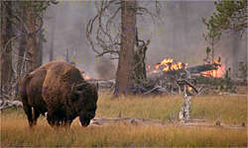

Slide 24
Equipment Hazards
Cuts (saws, tools, etc.)
Burns from mufflers (pumps, saws, etc.)
Noise (hearing impairment levels)
Foreign objects thrown from moving parts
Hand tools (pulaski, shovel, etc.)
Dozers, tractors/plows, etc.)

Slide 25
Aircraft (rotor and fixed wing) Hazards
Retardant drops
Bucket drops
Sling loads
Helicopter rotor wash breaking trees and snags (tops, branches, limbs, etc.)
Transport of personnel

Slide 26
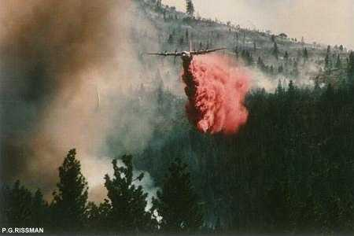

Slide 28
Fire Environment Hazards
The actual fire (running, smoldering, creeping)
Burns
Smoke
Unexpected or erratic winds
Darkness
Falling snags

Slide 29
Base/Camp Related Hazards
Sleeping areas
Sanitation
Maintaining personal hygiene
Food

Slide 30
Hazards Trees and Snags
Living
Dying (still alive, but with little or no chance of recovery)
Dead (snags)

Slide 31
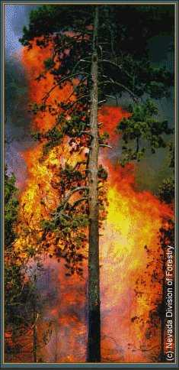

Slide 32
Working in Unsafe Areas
Do not enter the area until it is safe
Make the area safe to work in.
Fall snags and hazard trees
Identify the hazard
Provide a safe area
Communicate hazards to supervisor and adjoining forces
Provided you have received approval from your supervisor and you are qualified.

Slide 33
Firefighter Preparedness
Personal gear
Care and maintenance of personal gear
Accountability
Cleanliness and organization

Slide 34
Weight Limits

Slide 35
Personal Protective Equipment (PPE)
Hard hat
Eye protection
Hearing protection
Gloves
Flame resistant clothing - Nomex
Leather lace up work boots, 8 inch high
Socks

Slide 36
Personal Protective Equipment (PPE)
Fire shelters are required
Canteens are for drinking water
Headlamps

Slide 37
Personal Items
Eyeglasses
Jacket or Coat, Sweatshirt
Cotton under ware
Socks good quality
Personal hygienic gear
foot powder
tooth brush and paste
Rain gear

Slide 38
Problems associated with large wildfires
Too many people were reporting to one supervisor
Different emergency response structures
Lack of any structure for coordinated planning between agencies
Unclear lines of authority
Terminology differences between agencies
Unclear or unspecified incident objectives
Inadequate and incompatible communication systems

Slide 40
The Incident Command System
Span of control
Standard use of terminology
Consolidated use of action plans
Integrated communications
Predesignated incident facilities
Comprehensive resource management

Slide 41
Types of Crews
Organized Type I and II crews must be 18-20 persons.
Hand crews are usually used to construct fire line with cutting tools, scraping tools, smothering tools and chain saws.
Hand crews are also used to assist in making hose lays.

Slide 42
Type I Crews
Interagency Hotshot/Hotshot Crews
18-20 person smoke jumper crew
Are a national resource
Funded by fire management and is primary job

Slide 43
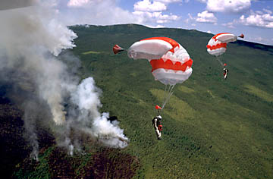

Slide 44
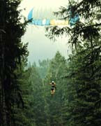

Slide 45
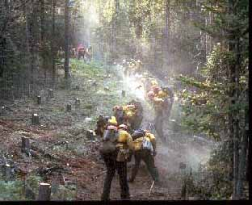

Slide 46
Type II Crews
Snake River Valley (SRV)
Southwest Firefighters (SWFF)
Montana Indian Fire fighters (MIFF)
Inmates
Agency Regulars
Alaskan Native
Job Corps
Emergency Hires (EFF)(CWN)(Blue card)

Slide 47
Engine Crews

Slide 48
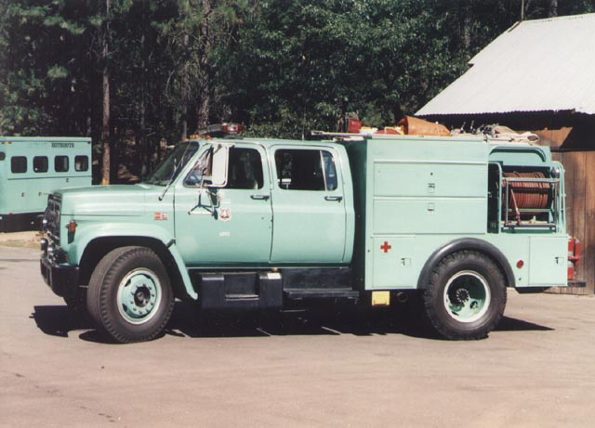

Slide 49
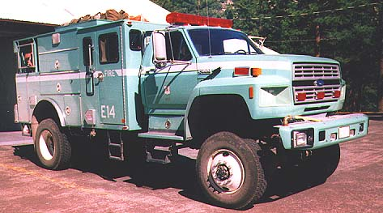

Slide 51
Helicopters

Slide 53
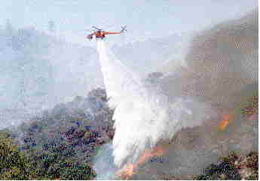

Slide 54
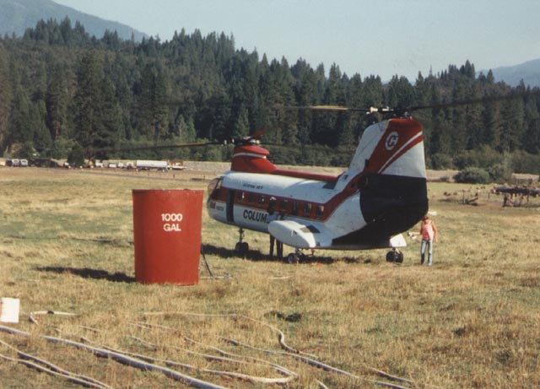

Slide 55
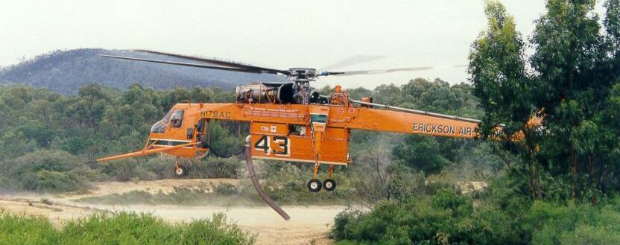

Slide 56
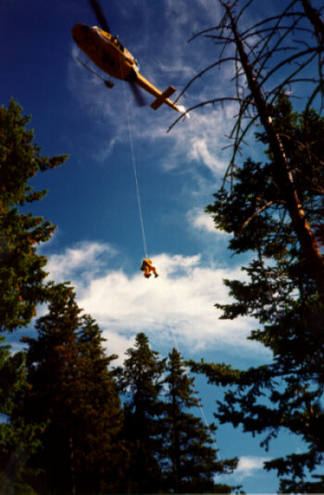

Slide 57
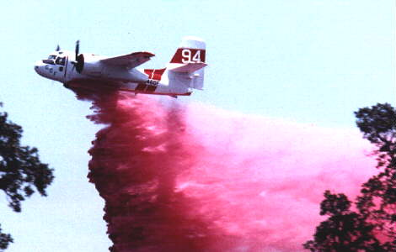

Slide 58
Common Problems Associated With Various Fire Crews
Safety practices and attitudes
Lack of training and experience
Off-shift showering etc.
Tools and equipment left on the fire line
Fatigue factors
Crew Morale
Security

Slide 59
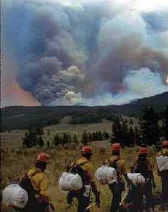

Slide 60
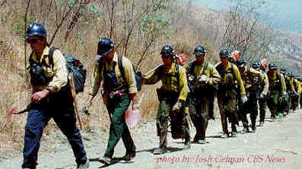

Slide 61
Transportation of Personnel and Tools Hazards Foot Travel
Whipping branches
Rolling rock or logs
Vehicles, tractors and ATV’s
Unstable footing
Stream or canal crossings
Avoid high log crossing
Watch the log not the water
In swift current face the stream, remove boots, loosen pack

Slide 62
Transportation of Personnel and Tools Hazards Foot Travel
Stump holes
Avoid root holes from upended trees
Watch out for burned stumps that may be hidden under ash layer
Beware of white ash that may indicate stump hole (test with stick or hand tool)
Locate hazards (poisonous insects, snakes or plants; polluted water

Slide 63
Firing Devices Objectives
Describe two hazards to operators when using a fusee
Given a fusee demonstrate or simulate how to ignite, use and extinguish

Slide 64
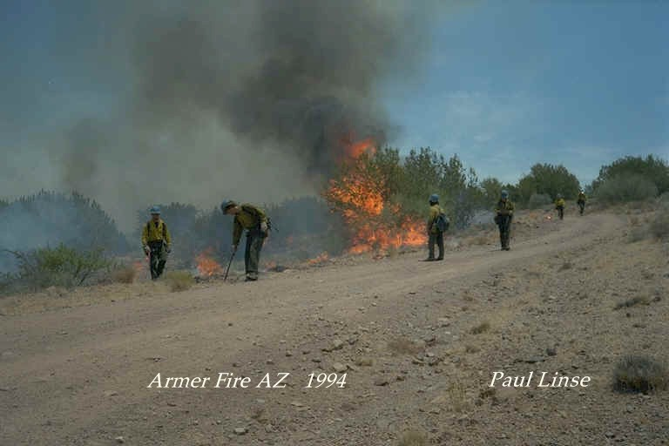

Slide 65
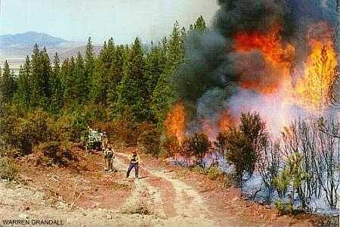

Slide 66
Water Use Hose Lays
Simple hose lays
Progressive hose lays

Slide 67
Water Use Water Patterns
Straight stream
Too hot to get too close
The fire is confined to a small area
A lot of pressure is needed to reach any distance
Targets cannot be reached with fog

Slide 68
Water Use Water Patterns
Fog
Needed for close work
Fire covers a larger area
A smaller volume of water is required to put the fire out
Fog patterns may be used when hot spotting, building wet line, direct attack and mop-up
Fog patterns provides the most personal protection

Slide 69
Water Use Water Applications
If fire is hot use straight steam to knock the flames down (if fog/spray will not work)
Direct the fog spray parallel to the edge at the base of the flames
Once on the edge continue with a fog pattern
Be sure fire is knocked down well before going further

Slide 70
Water Use Water Applications
Watch the extinguished edge and behind in case of flare-ups
Follow up wet line with hand line as soon as possible, especially in heavy fuels
Aim accurately and maintain water stream in a sweeping motion
Apply water intermittently
Conserves water
Determines if more water is needed

Slide 71
Suppression Objectives
Name parts of a fire
Describe three methods of attack
Describe four kinds of fire control line
Describe black line concept
Describe three methods for breaking the fire triangle

Slide 72
Suppression Objectives
Describe five fire behavior terms
Name four hazards to an existing control line when burning inside the fire line
Describe the proper follow-up procedure for a tractor plow fire line for fire line personnel
Describe two kinds of coordinated crew techniques used for fire line construction

Slide 73
Suppression Objectives
Describe safety procedures to follow when in an area where retardant/water drops are being made
Describe five safety procedures to follow when working around dozers, tractor plows and engines

Slide 74
Suppression Parts of a Fire
Head
Finger
Flank
Rear
Perimeter
Island
Pocket

Slide 75
Suppression Parts of a Fire
Origin
Anchor point
Spot fires

Slide 76
Suppression Methods of Attack
Direct attack
Indirect attack
Parallel attack

Slide 77
Suppression Black-line Concept
The only safe line is a black line
Fuels that remain between the main fire and the control line are burned out, or allowed to burn to the control line
This method ensures that fuels and heat remain inside the control line and prevents the fire from making a run at the control line

Slide 78
Suppression Type of Fire Control Line
Constructed fire line
Hand line
Machine line
Wet line
Retardant line
Detonation line

Slide 79
Suppression Type of Fire Control Line
Natural control line
Cold fire edge
Fuel break
Streams, lakes, ponds, rock slides and areas of sparse fuels
Previously constructed barriers
Roads, canals, etc.

Slide 80
Suppression The Fire Triangle
Fuel - any combustible material
Oxygen - in the air
Heat - a source of ignition

Slide 81
Suppression Methods for Breaking the Fire Triangle
Fuel - Separate the fuel to prevent combustion or remove fuel during fire line construction
Oxygen - Suffocate the fire with dirt or water to rob the fire of oxygen
Heat - Cool the fire by applying water, dirt, retardant or a combination

Slide 82
Suppression Fire Line Construction Standards
Fuel type
Fuel moisture
Continuity and arrangement
Temperatures
Increases in wind

Slide 83
Suppression Fire Line Construction Standards
Fuel type
Forest
Desert
Tundra
Fuel moisture
The lower the fuel moisture the greater the chances for combustion and fire spread

Slide 84
Suppression Fire Line Construction Standards
Continuity and arrangement
The closer and more continuous the fuels, both horizontally and vertically, the greater the chance for combustion and fire spread (heavy fuel loading, ladder fuels)

Slide 85
Suppression Fire Line Construction Standards
Temperatures
Will inversely effect the fuel moisture
The higher the temperature the lower the fuel moisture
As fires burn more intensely, more heat is produced and combustion and fire spread increases

Slide 86
Suppression Fire Line Construction Standards
Wind
Increases in wind will increase the amount of oxygen available, increasing the chances for combustion, spotting and fire spread

Slide 87
Suppression Fire Behavior Description
Smoldering
Creeping
Running
Spotting
Crowning

Slide 88
Suppression Threats to Existing Control Lines
Spotting
Rolling debris
Creeping
Radiant heat

Slide 89
Suppression Tractor Fire Line Procedures
Clean-up
Break-machine pile and berms
Fireproof needed areas
Prepare and burn out control line
Limb up trees
Snags that threaten control lines
Mop-up interior
Patrol control lines

Slide 90
Suppression Coordinated Crew Techniques
Progressive line construction
Bump-up
One-lick
Wedge
Reverse wedge
Leap frog method

Slide 91
Suppression Retardant/Water Drop Safety Procedures
Move back into the area quickly to take advantage of retardant
Remember that the area may be slick after retardant drops

Slide 92
Suppression Retardant/Water Drop Safety Procedures
Lie down facing oncoming aircraft
Helmet on with chinstrap, feet spread, goggles in place
Hold hand tool at side
Grab something solid
Rock
Tree
Shrub

Slide 93
Suppression Retardant/Water Drop Safety Procedures
After initial drop move out of the area until you have received assurance that no more drops are to be made in the area

Slide 94
Suppression Safety Procedures Used Around Fire line Equipment - Engines
Be alert when engine is moving
Be alert to hazards of a charged hose line
Nozzle operators and personnel nearby must wear eye protection
Be alert and on the lookout for rolling materials when working uphill or downhill of equipment

Slide 95
Suppression Safety Procedures Used Around Fire line Equipment - Tractors
Be alert to moving equipment
Tractors always have the right-of-way
Maintain 50 foot minimum distance
Be careful and maintain stable footing when working around winch cables
Work a safe distance away depending on fuels and terrain

Slide 96
Suppression Safety Procedures Used Around Fire line Equipment - Tractors
Do not assume the operator knows where you are
Be alert to night operations
Do not sleep on the fire line

Slide 97
Suppression Securing the Control Line Objectives
Describe how each of the four senses aid in detecting burning materials
Discuss the importance of breaking up and dispersing accumulations of fuel adjacent to the fire line
Demonstrate the technique of cold-trailing

Slide 98
Suppression Securing the Control Line Objectives
Given a constructed control-line, strengthen the line to facilitate holding by rearranging and fireproofing fuels adjacent to fire-line
State three factors that determine the amount of additional work required for a water or retardant line

Slide 99
Suppression Methods of Mop-up
Dry mop-up
Scraping
Digging
Stirring
Mixing
Separating
Turning logs

Slide 100
Suppression Methods of Mop-up
Wet Mop-up (water application)
Apply in fine spray
Apply from control line towards the inside of the burn
Apply from outside the burn area inwards to the center of the burned area
Use straight stream to penetrate or reach a target (begin from the base of the tree and work to the top of the tree)

Slide 101
Suppression Methods of Mop-up
Wet Mop-up
Use hand tools in combination with soil and water
Scraping
Digging
Stirring Mixing
Separating

Slide 102
Suppression Mop-up - Hazards in the General Area
Overhanging trees
Snags
Leaning trees (leaners)
Branches, tree tops, loose tree bark
Hanging trees
Trees with roots burned away
Cat faced trees

Slide 103
Suppression Mop-up - Hazards Associated with Water Use
Hot rocks
White ash
Fire pits
Ground fire
Rock and dirt particles
Be aware not only of yourself, but for those working around you.

Slide 104
Suppression Systematic Mop-up
Start with the hottest area and progress toward the coolest
Plan a beginning and ending point
Work inward from the control line
Examine the entire assigned area
Make sure instructions are clear. Ask questions???

Slide 105
Suppression Using the Four Senses - Mop-up
Sight
Smoke - Look up as well as down. A treetop may be on fire
Heat waves
Steam
White ash - White ash indicates heat and burning, the ash may be covering hot embers
Stump holes

Slide 106
Suppression Using the Four Senses - Mop-up
Sight
Gnats - Gnats often hover over hot spots
Select an advantageous spot to rest to observe for signs of hot spots
Look facing into the sun in shaded areas to see small smokes

Slide 107
Suppression Using the Four Senses - Mop-up
Touch
Do not wear gloves
At first, feel about 1 inch away using the back or the hand, then carefully with direct contact

Slide 108
Suppression Using the Four Senses - Mop-up
Smell
Smoke
Burning materials and gases that these materials give off

Slide 109
Suppression Using the Four Senses - Mop-up
Hearing - listen for the:
Crack and pop of burning materials
Hiss when water touches hot materials

Slide 110
Suppression Mop-up
Patrol along control lines to check for spot fires and heat to prevent escaping. Patrol both sides of the control line.

Slide 111
Suppression Reinforce Treated Areas - Mop-up
Construct fire line
Limb up nearby trees and brush
Fireproof fuels outside the control
Have snags fallen

Slide 112
